Slide 1

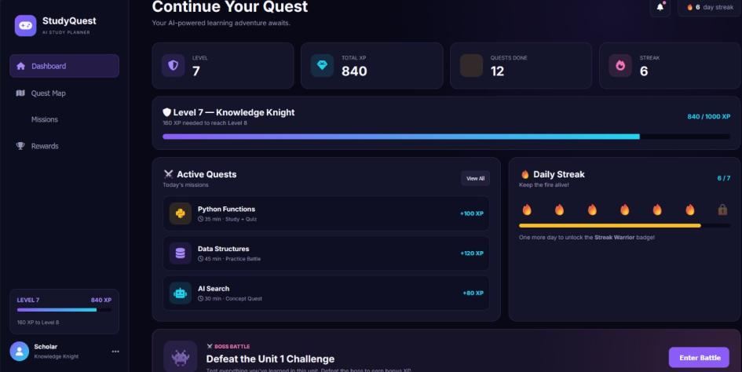

FOUNDATIONS OF ARTIFICIAL INTELLIGENCE · PROJECT REVIEW
StudyQuest AI
A Game-Based Study Planner
Turning study plans into quests, XP and boss battles
SUBMITTED BY
GUIDED BY
Thendral V
2116240701567
Varnika V
2116240701578
Mrs. B. Deepa
Assistant Professor (SG)
Dept. of CSE, REC
October 2026
Notes:
Introduce the project title, the team members and the faculty guide. One-line pitch: StudyQuest AI turns a student's study plan into a game, with quests, experience points, streaks and boss battles.

Slide 2



Why students need a better study planner
01 · INTRODUCTION
Heavy academic workload
Many subjects, complex topics and close exam dates are hard to organise.
OUR APPROACH
Study planning
+
Game mechanics
Static timetables
A web app that turns study activities into quests a student completes step by step
Dashboard tracks XP, levels, completed quests and daily streaks
Quest route: learn the concept, practise, take a quiz, then face the boss
Built with HTML, CSS and JavaScript using rule-based logic
Manual timetables and to-do lists give structure but no engagement.
Motivation drops
Without feedback or rewards, consistent study habits are hard to keep.
Notes:
Explain the problem: heavy workload, timetables that do not engage, and falling motivation. Then introduce our idea: combine study planning with gamification. Mention honestly that the current version is rule-based, not a trained ML model.

Slide 3




What nine studies tell us
02 · LITERATURE REVIEW
Gamification design
Evidence on gamification
Motivation, learning & AI
Deterding et al. (2011)
Defined gamification: game elements in non-game contexts
Werbach & Hunter (2012)
Mechanics and dynamics for gamified systems
Kapp (2012)
Game-based learning and instructional design
Hamari et al. (2014)
Effects vary by context and implementation
Sailer et al. (2017)
Specific elements affect need satisfaction
Dichev & Dicheva (2017)
Long-term educational benefit still uncertain
Deci & Ryan (2000)
Autonomy, competence and relatedness drive motivation
Dunlosky et al. (2013)
Practice testing and distributed practice work
Russell & Norvig (2021)
Agents, search and decision-making foundations
Research gap: theories explain motivation and studies test single game elements, but few bring planning, practice and rewards together in one study tool. StudyQuest AI combines them.
Notes:
Group the nine references into three themes. Key takeaway: existing work gives theory or tests single game elements; our project integrates study planning, quizzes and rewards into one application.

Slide 4








From study inputs to a quest route
03 · PROPOSED SYSTEM
PLAYER INPUTS
1
2
3
4
Subject
Available study time
Concept Quest
Practice Battle
AI Quiz
Boss Battle
Exam date
Read and understand the topic
Work through examples
Check understanding with questions
Final challenge for bonus XP
Planning strategy
Quest flow: start / pause / reset the timer → tick 3 objectives → Complete Quest unlocks → XP and quest count update
Notes:
Walk through how a student uses the system: enter subject, time, exam date and strategy; the app generates a four-stage route. Each quest has a timer and three objectives that must be ticked before it can be completed.

Slide 5
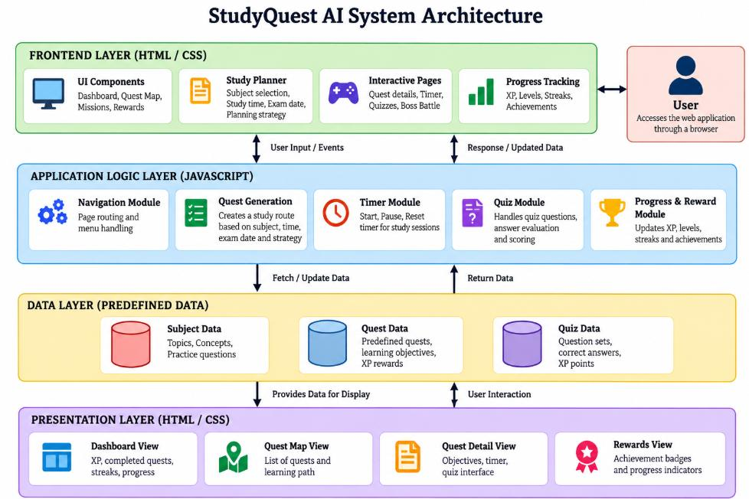
Four layers, all running in the browser
04 · ARCHITECTURE
Frontend (HTML/CSS)
UI components, study planner form, interactive pages, progress tracking
Application logic (JS)
Navigation, quest generation, timer, quiz scoring, progress and rewards
Data (predefined)
Subject data, quest data and quiz data held in JavaScript
Presentation
Dashboard, Quest Map, Quest Detail and Rewards views
No backend server or database in the current version
Notes:
Explain the layered architecture: user events go to the JavaScript logic layer, which reads predefined data and updates the views. Everything runs client-side; there is no backend or database yet.

Slide 6




Five modules power the game loop
05 · MODULES
MODULE 1
MODULE 2
MODULE 3
MODULE 4
MODULE 5
Dashboard & Navigation
Study Planning & Quest Generation
Quest Management & Timer
Missions & Boss Battle
Rewards & Progress
Shows XP, completed quests, streak and active quests; links every page
Builds the Concept → Practice → Quiz → Boss route from user inputs
Countdown timer, 3 objectives, Complete Quest unlocked only when all are done
Python quiz vs. the Code Goblin: right answer wins XP, wrong answer −20 HP
Quest Master, Streak Warrior, Quiz Slayer and Boss Hunter badges
Notes:
Briefly describe each module. Module 3 enforces the three objectives before completion. Module 4 boss battle: the Code Goblin starts at 100 HP; a wrong answer removes 20 HP, a correct one defeats it and gives bonus XP once.

Slide 7



Experimental setup and game rules
06 · IMPLEMENTATION
HTML
100 HP
−20 HP
Page structure: Dashboard, Quest Map, Missions, Rewards
Code Goblin starting health
per wrong boss-battle answer
CSS
Dark game-style layout, colours and responsive design
3
+100 XP
JavaScript
Navigation, quest data, timer, objective checks, quiz and XP logic
objectives to unlock Complete Quest
for a quest such as Python Functions
Testing: every feature was exercised in the browser; navigation, route generation, timer, objective checks, boss battle and XP updates worked as intended.
Notes:
Tech stack: HTML for structure, CSS for styling, JavaScript for all logic. Highlight the game rules. Testing was functional testing of each feature in the browser.

Slide 8
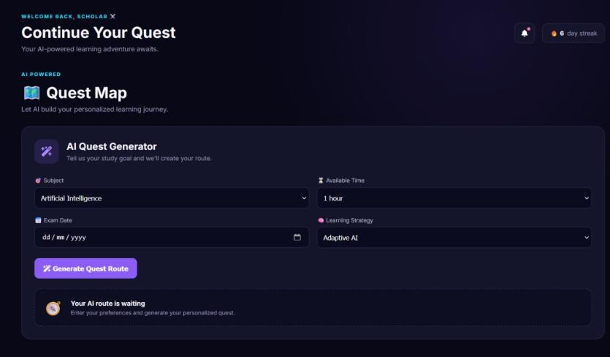
Dashboard and Quest Map
07 · RESULTS
Dashboard
Quest Map
Level 7 · 840 XP · 12 quests done · 6-day streak, with active quests and a boss-battle shortcut
AI Quest Generator takes subject, time, exam date and strategy, then builds the route
Notes:
Show the dashboard: level, total XP, quests done and streak at a glance. Then the Quest Map where the student enters preferences and generates a study route.

Slide 9
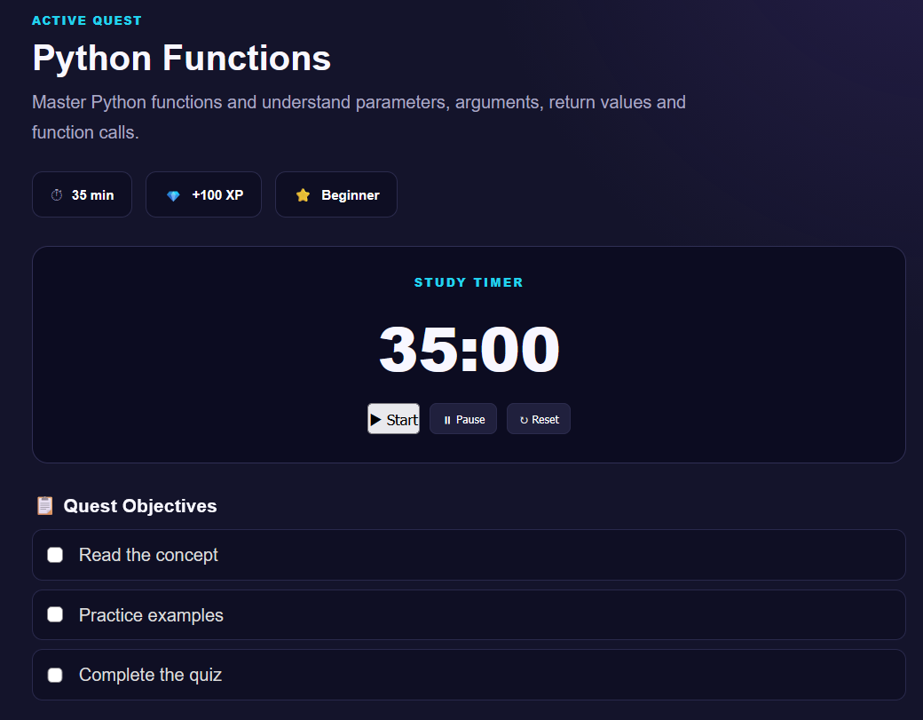
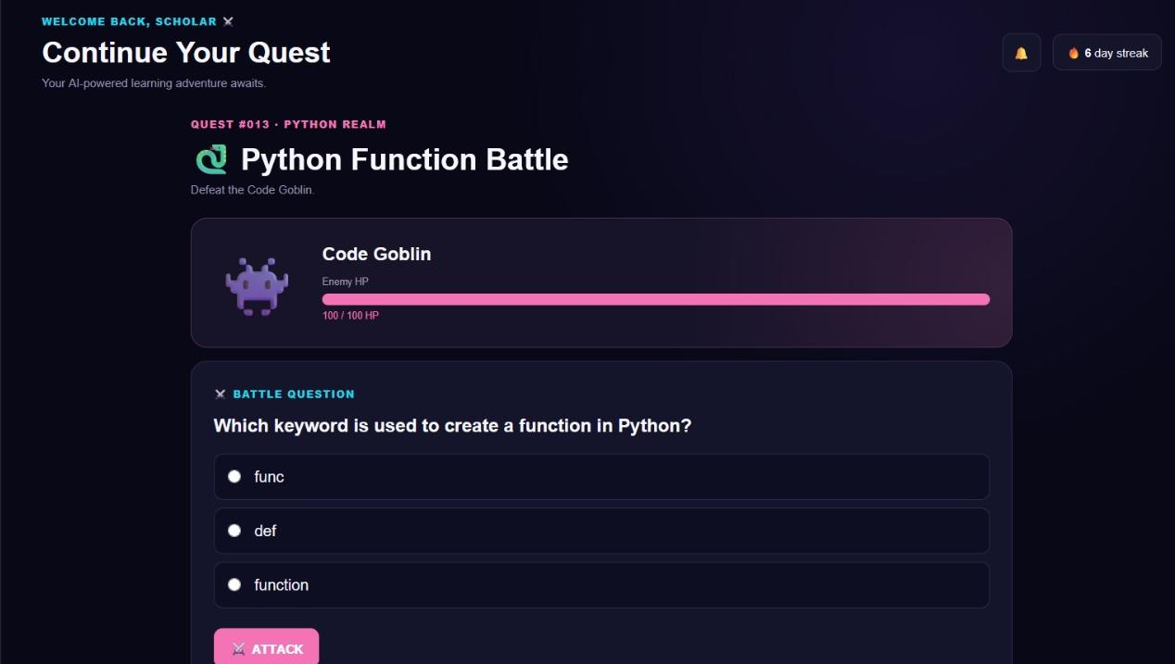
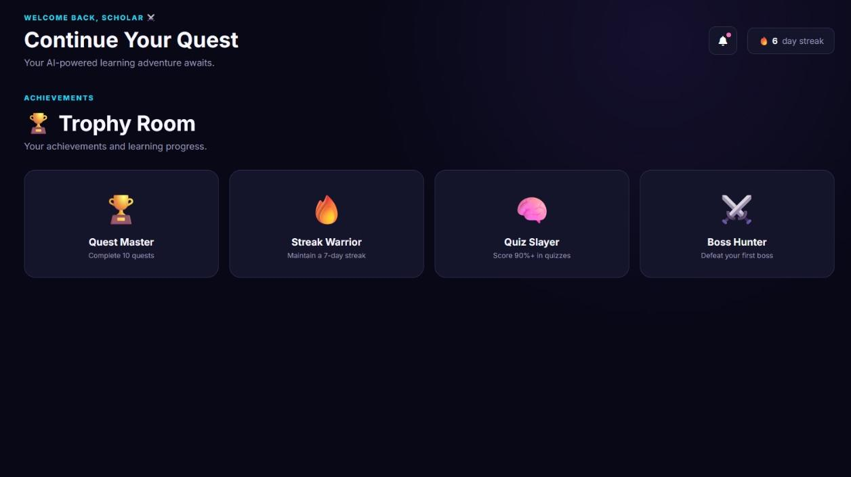
Quests, boss battle and trophies
07 · RESULTS
Quest Detail & Timer
Python Function Battle
Trophy Room
35-minute timer with start, pause and reset; three objectives to tick
Answer correctly to defeat the Code Goblin and earn bonus XP
Quest Master, Streak Warrior, Quiz Slayer and Boss Hunter badges
Notes:
Quest Detail: timer and objectives. Boss battle: a multiple-choice Python question; correct answers defeat the boss, wrong ones reduce its HP. Rewards: the Trophy Room shows achievement badges.

Slide 10




Level complete, next level loading
08 · CONCLUSION & FUTURE WORK
NEXT LEVEL
WHAT WE ACHIEVED
Adaptive scheduling
A working gamified study planner: quests, timer, quizzes, XP, streaks and badges
Students can generate routes, finish objectives and fight quiz-based boss battles
Limits: rule-based logic and predefined data; no ML model, no persistent storage, no formal study of learning gains yet
Plans built from exam dates, hours and topic difficulty
Personalised recommendations
ML on student performance
Persistent progress
Database for XP, quests and badges
Analytics & larger quiz bank
Subject-wise quizzes, insights, reminders
Thank you! Questions?
Notes:
Summarise what works today and be upfront about the limitations. Future work: adaptive scheduling, ML-based recommendations, database persistence, analytics and a bigger question bank, plus a user study to measure impact. Thank the panel and invite questions.

